Slide 1
PSCS_46_Application for Assessment of Quality of Textbook/ Reference Books/ E-Books
CSE 7101- Capstone Project
Review-3
Batch Number: CSE_23
Roll Number | Student Name
20221CSE0234 | Syed Thousif
20221CSE0213 | Patil Jashwanth Reddy
20221CSE0211 | Kambam Nithin Kumar Reddy
Under the Supervision of,
Ms. Kummara Sruthi
Assistant Professor
School of Computer Science and Engineering
Presidency University
Name of the Program: CSE-Computer Science and Engineering
Name of the HOD: Dr. Asif Mohammed, Dr. Blessed Prince
Name of the Program Project Coordinator: Mr. Muthuraju V
Name of the School Project Coordinators: Dr. Sampath A K , Dr. Geetha A

Slide 2
Content
Abstract
Objectives
Analysis and Design
Source Code details
Modules
Technologies used
Timeline of the Project (Gantt Chart)
References

Slide 3
Abstract
Application to assess quality of Textbooks / Reference Books / E-Books
Uses AI (Gemini) to evaluate content accuracy, readability and consistency
Supports PDF, DOCX, TXT and camera-captured images of pages
Stores evaluations and files in MongoDB for future review
Helps teachers and reviewers take data-driven decisions on learning materials

Slide 4
Objectives
To automate preliminary quality assessment of academic materials
To provide quantitative scores for accuracy, readability and consistency
To support multiple input modes – file upload and live camera capture
To maintain user-wise history of all evaluations
To act as a decision support tool, not a replacement for expert review

Slide 5
Analysis and Design
Actors: Reviewer (user), AI Evaluation Engine, Database
Functional flow: Login → Upload / Capture → AI Evaluation → Store → View Results / History
Architecture: Web client (HTML/JS) + Flask backend + Gemini API + MongoDB
Data design:
Users collection – login details
Evaluations collection – scores, explanations, summary, file info
GridFS – stores original documents / images
UI design: Single dashboard for upload, camera capture, result card and history panel

Slide 6
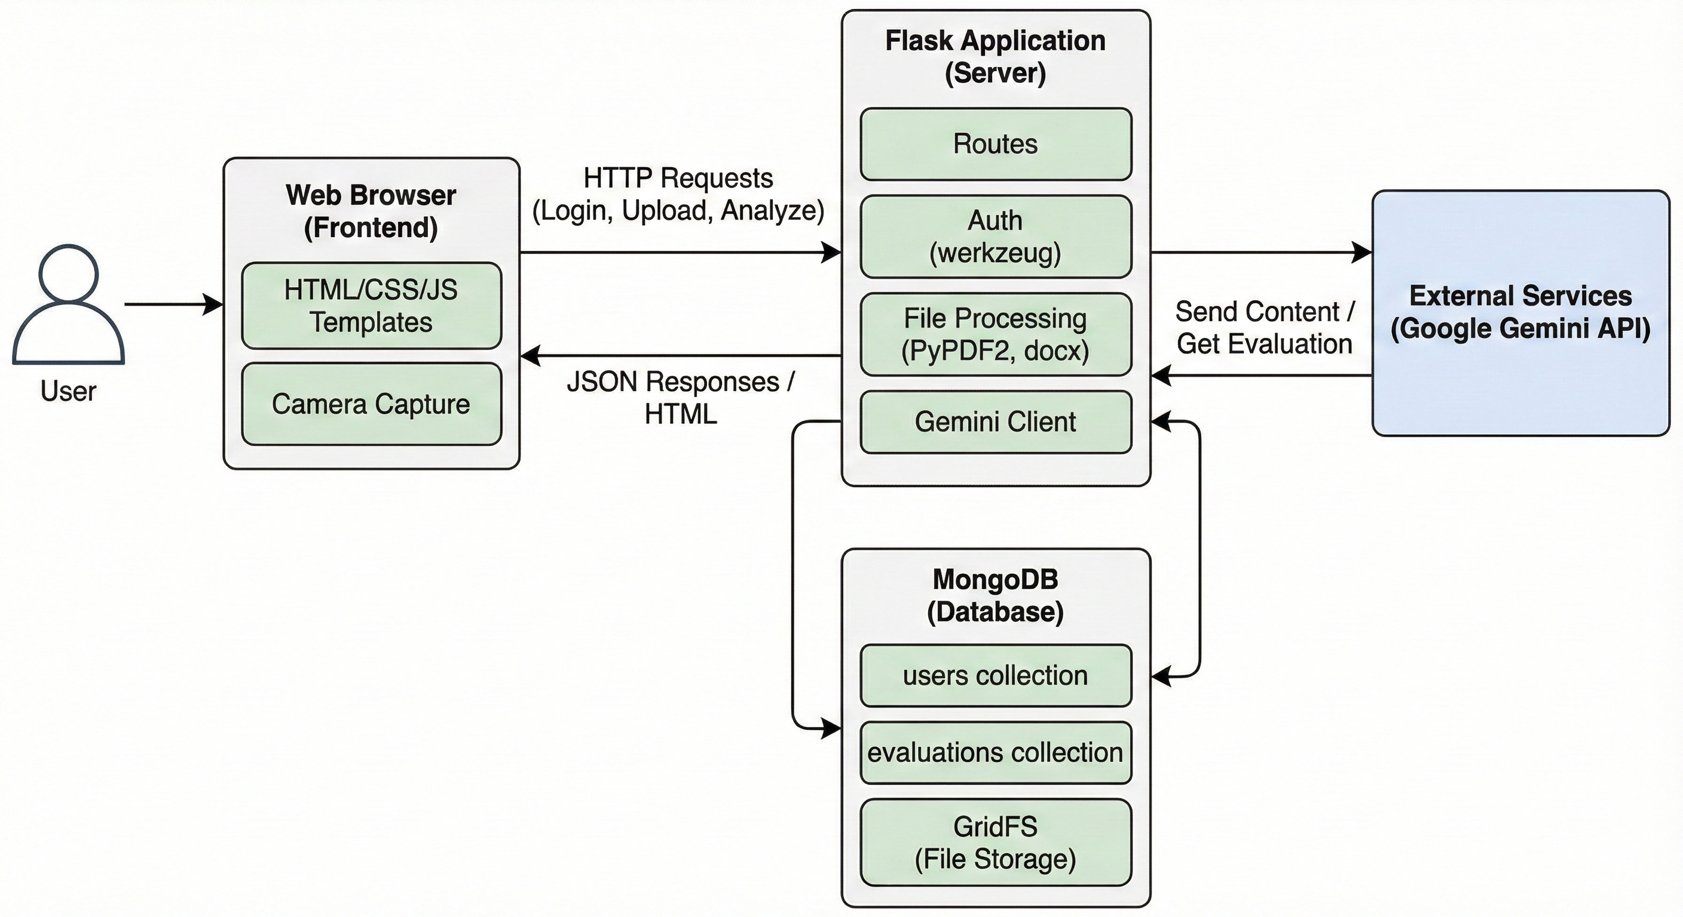
Analysis and Design
System Architecture

Slide 7
Source Code
Single main file: Project.py containing routes, logic and templates
Flask routes:
/register, /login, /logout – user management
/ – main dashboard
/analyze – file/image processing and AI call
/user_history – fetch recent evaluations
Helper functions:
extract_text_from_file_bytes() – PDF/DOCX/TXT text extraction
evaluate_textbook_gemini() – prompt + schema-based Gemini call
Uses GridFS for storing uploaded file bytes and JSON for AI response

Slide 8
Modules
User Authentication Module
Register, login, secure password hashing, session handling
File & Camera Input Module
File upload, MIME type detection, integrated camera access and capture
Text Extraction Module
Reads text from PDF, DOCX and TXT, with size limitation
AI Evaluation Module
Sends content to Gemini, receives scores and explanations
Storage & History Module
Saves evaluation details in MongoDB and displays recent history in UI
Result Visualization Module
Shows structured card with scores, comments and summary

Slide 9
Technologies Used
Programming Language: Python
Backend Framework: Flask
Database: MongoDB + GridFS
AI / LLM: Google Gemini API (google.genai)
Libraries: PyPDF2, python-docx, Werkzeug security, BSON, JSON
Frontend: HTML5, CSS3, JavaScript, Lucide icons
Tools / Platform: VS Code / PyCharm, Browser, MongoDB Compass / Atlas

Slide 10
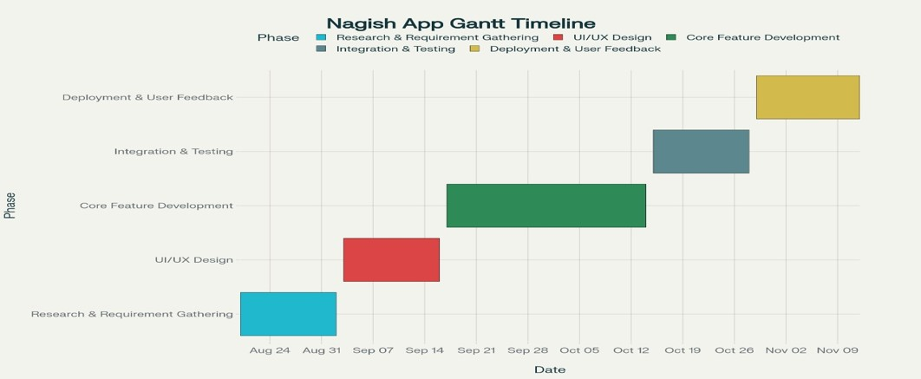
Timeline of the Project (Gantt Chart)
Gantt Chart

Slide 11
References (IEEE Paper format)
[1] Application for Assessment of Quality of Textbook/Reference Book/E-Books, International Journal of Engineering Innovations and Management Strategies, published circa early 2025 (about six months ago) IJEIMS.
[2] Q. Zhou, “Evaluating book impacts via integrating multi-source reviews,” Scientometrics, vol. 129, 2024
[3] R. K. Singh and A. Sharma, "Design and development of web-based evaluation system for academic resources," International Journal of Computer Applications, vol. 183, no. 8, pp. 25–30, June 2021.
[4] S. R. K. Somasekhar, P. V. Kumar, and R. J. Reddy, "Automated assessment of educational content using multi-criteria analysis," in Proc. IEEE International Conf. on Technology for Education (T4E), Mumbai, India, 2020, pp. 215–220.
[5] M. A. Al-Emran, "Towards an intelligent framework for textbook evaluation in higher education," Education and Information Technologies, vol. 24, no. 2, pp. 1453–1468, Mar. 2019.
[6] N. G. T. Izquierdo, L. A. G. Villalobos, and J. D. M. Ramírez, "A framework for the evaluation of e-learning materials," in Proc. IEEE Global Engineering Education Conf. (EDUCON), Abu Dhabi, UAE, 2016, pp. 1129–1134.
[7] T. M. Connolly and E. A. Stansfield, "Evaluating the quality of learning resources: A web-based approach," in Proc. IEEE International Conf. on Advanced Learning Technologies (ICALT), Athens, Greece, 2014, pp. 37–41.

Slide 12


